Slide 1
The Importance of Corporate Social Responsibility

Slide 2
Project Objective
What is CSR?
CSR is a business management practice that involves assessing and managing risks and opportunities that arise from environmental, social, and economic impacts of the company and its industry
Why is CSR Important?
Sustainability reporting is the future of business
All publicly traded companies within the EU will be required to report on sustainability in 2017
A PwC survey found that 1/3 investors considered sustainability in their investment strategy
The State of California requires all retail sellers and manufacturers having worldwide annual revenues of $100 million or more to disclose sustainability reporting
Improve risk management
Improves ability to retain and attract employees
Enhance reputation
How does CSR apply to BKFS?

Slide 3

How do we tell the story?
Issues with telling CSR story
It has a specific stereotype (Sustainability = Environment)
“These kids are hippies”
It is a HUGE topic
We only have 20 minutes to tell the story
We hate public speaking

Slide 4
How do we sell the idea?
The Mission Statement
We must relate everything back to the mission statement and QVR
Financial Savings and Trends
The executives care about how this can save them $$$$
They also care how this makes their shareholders more $$$$
Data = Success
Policy and Risk
Risk is important to BKFS
Policy is important to all Companies

Slide 5
How do we utilize the team?
2 Computer Science Majors
2 Finance Majors
1 Marketing Major
1 Sustainability Major
1 Political Science Major

Slide 6
Gri Report
What some challenges for the hr department attracting new employees
Business to business companies

Slide 7
The Importance of Corporate Social Responsibility
By: team ballin’

Slide 8
WOW Factor (Monica)
Video

Slide 9
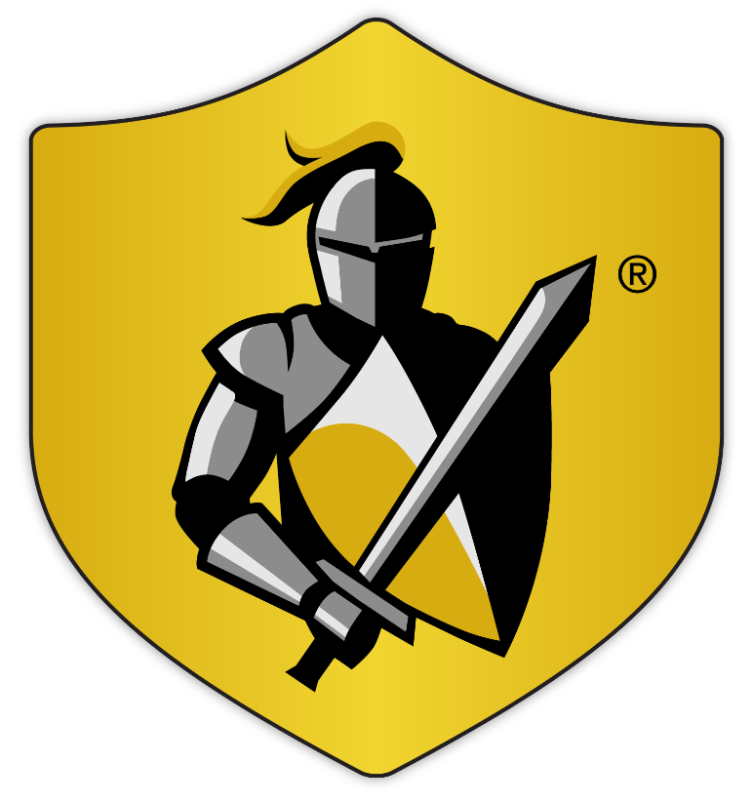
The Black Knight Mission (Olivia)
To be the PREMIER BRAND for technology in the mortgage industry known for PRODUCT EXCELLENCE and to deliver INNOVATIVE, SEAMLESSLY INTEGRATED PRODUCTS with SUPERIOR CAPABILITIES, FUNCTIONALITY and SUPPORT that enable our clients to:
Better manage and mitigate risk
Realize greater efficiencies and drive improved financial performance

Slide 10
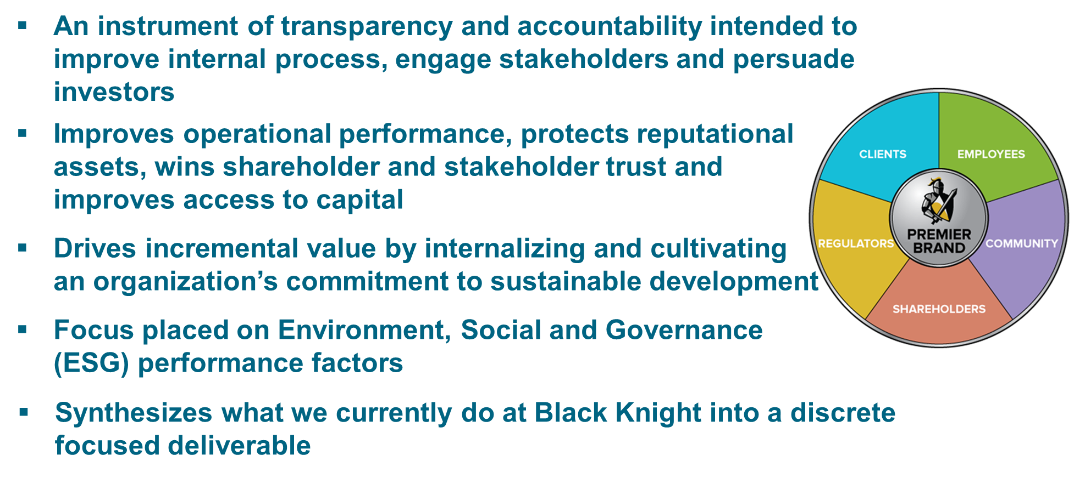
Corporate Sustainability (Monica + Pat)

Slide 11
What is Corporate Sustainability? (Monica + Pat)
An instrument of transparency and accountability intended to improve internal process
Designed to engage stakeholders and persuade investors
Focus placed on Environment, Social and Governance (ESG) performance factors
Applies the same rigor to non-financial reporting as is applied to financial reporting

Slide 12
Why is Corporate Sustainability important? (Monica + Pat)
Improves operational performance
Protects reputational assets
Addresses organizational risk
Wins shareholder and stakeholder trust
Improves access to capital
Drives incremental value by internalizing and cultivating an organization’s commitment to sustainable development
Synthesizes what we currently do at Black Knight into a discrete focused deliverable, delivering incremental value to the organization

Slide 13
Identify the Stakeholders
BKFS
Investors
Regulators
Employees
Community
Customers

Slide 14
CSR and its impact on QVR (Carlton)
Q
V
R
Greater Control
Lower Costs
Mitigate Risk

Slide 15
Finance and Trends (Terry, Olivia, Carlton, Pat)

Slide 16
Risk (Olivia)

Slide 17
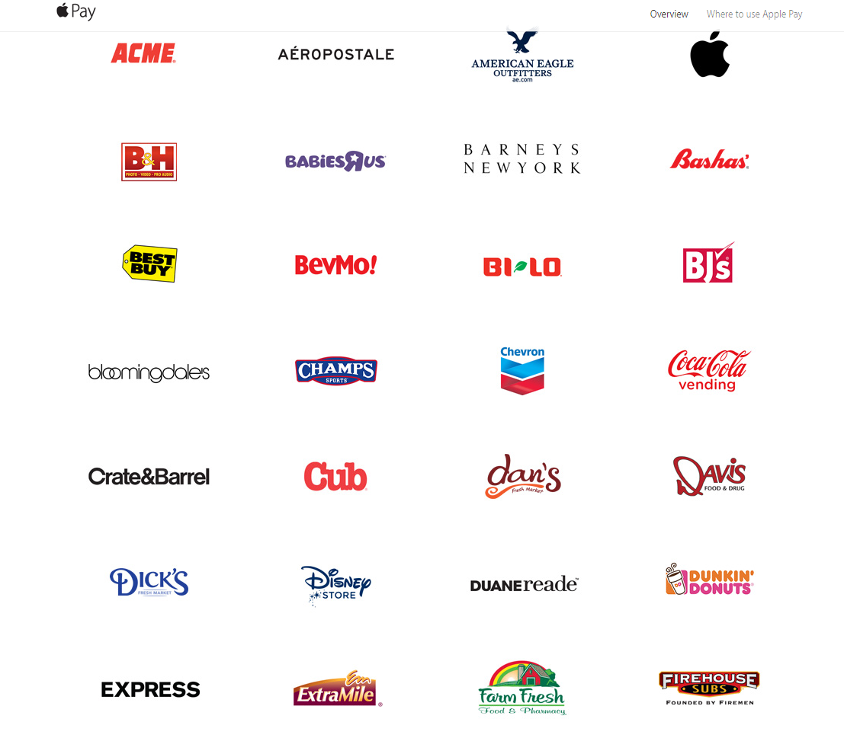
Who is doing it (Terry)

Slide 18
“We already do this” (Monica)

Slide 19
How do we measure this? (Monica + Pat)
3
5
10

Slide 20
Action Items
Everybody needs to have an action Item

